Slide 1
Python - Loops
ICT Learning Centre @ UL - Python and ML Foundations

Slide 2
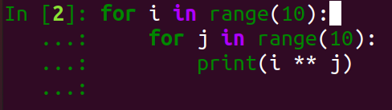
Loops
Executing code repeatedly

Slide 3
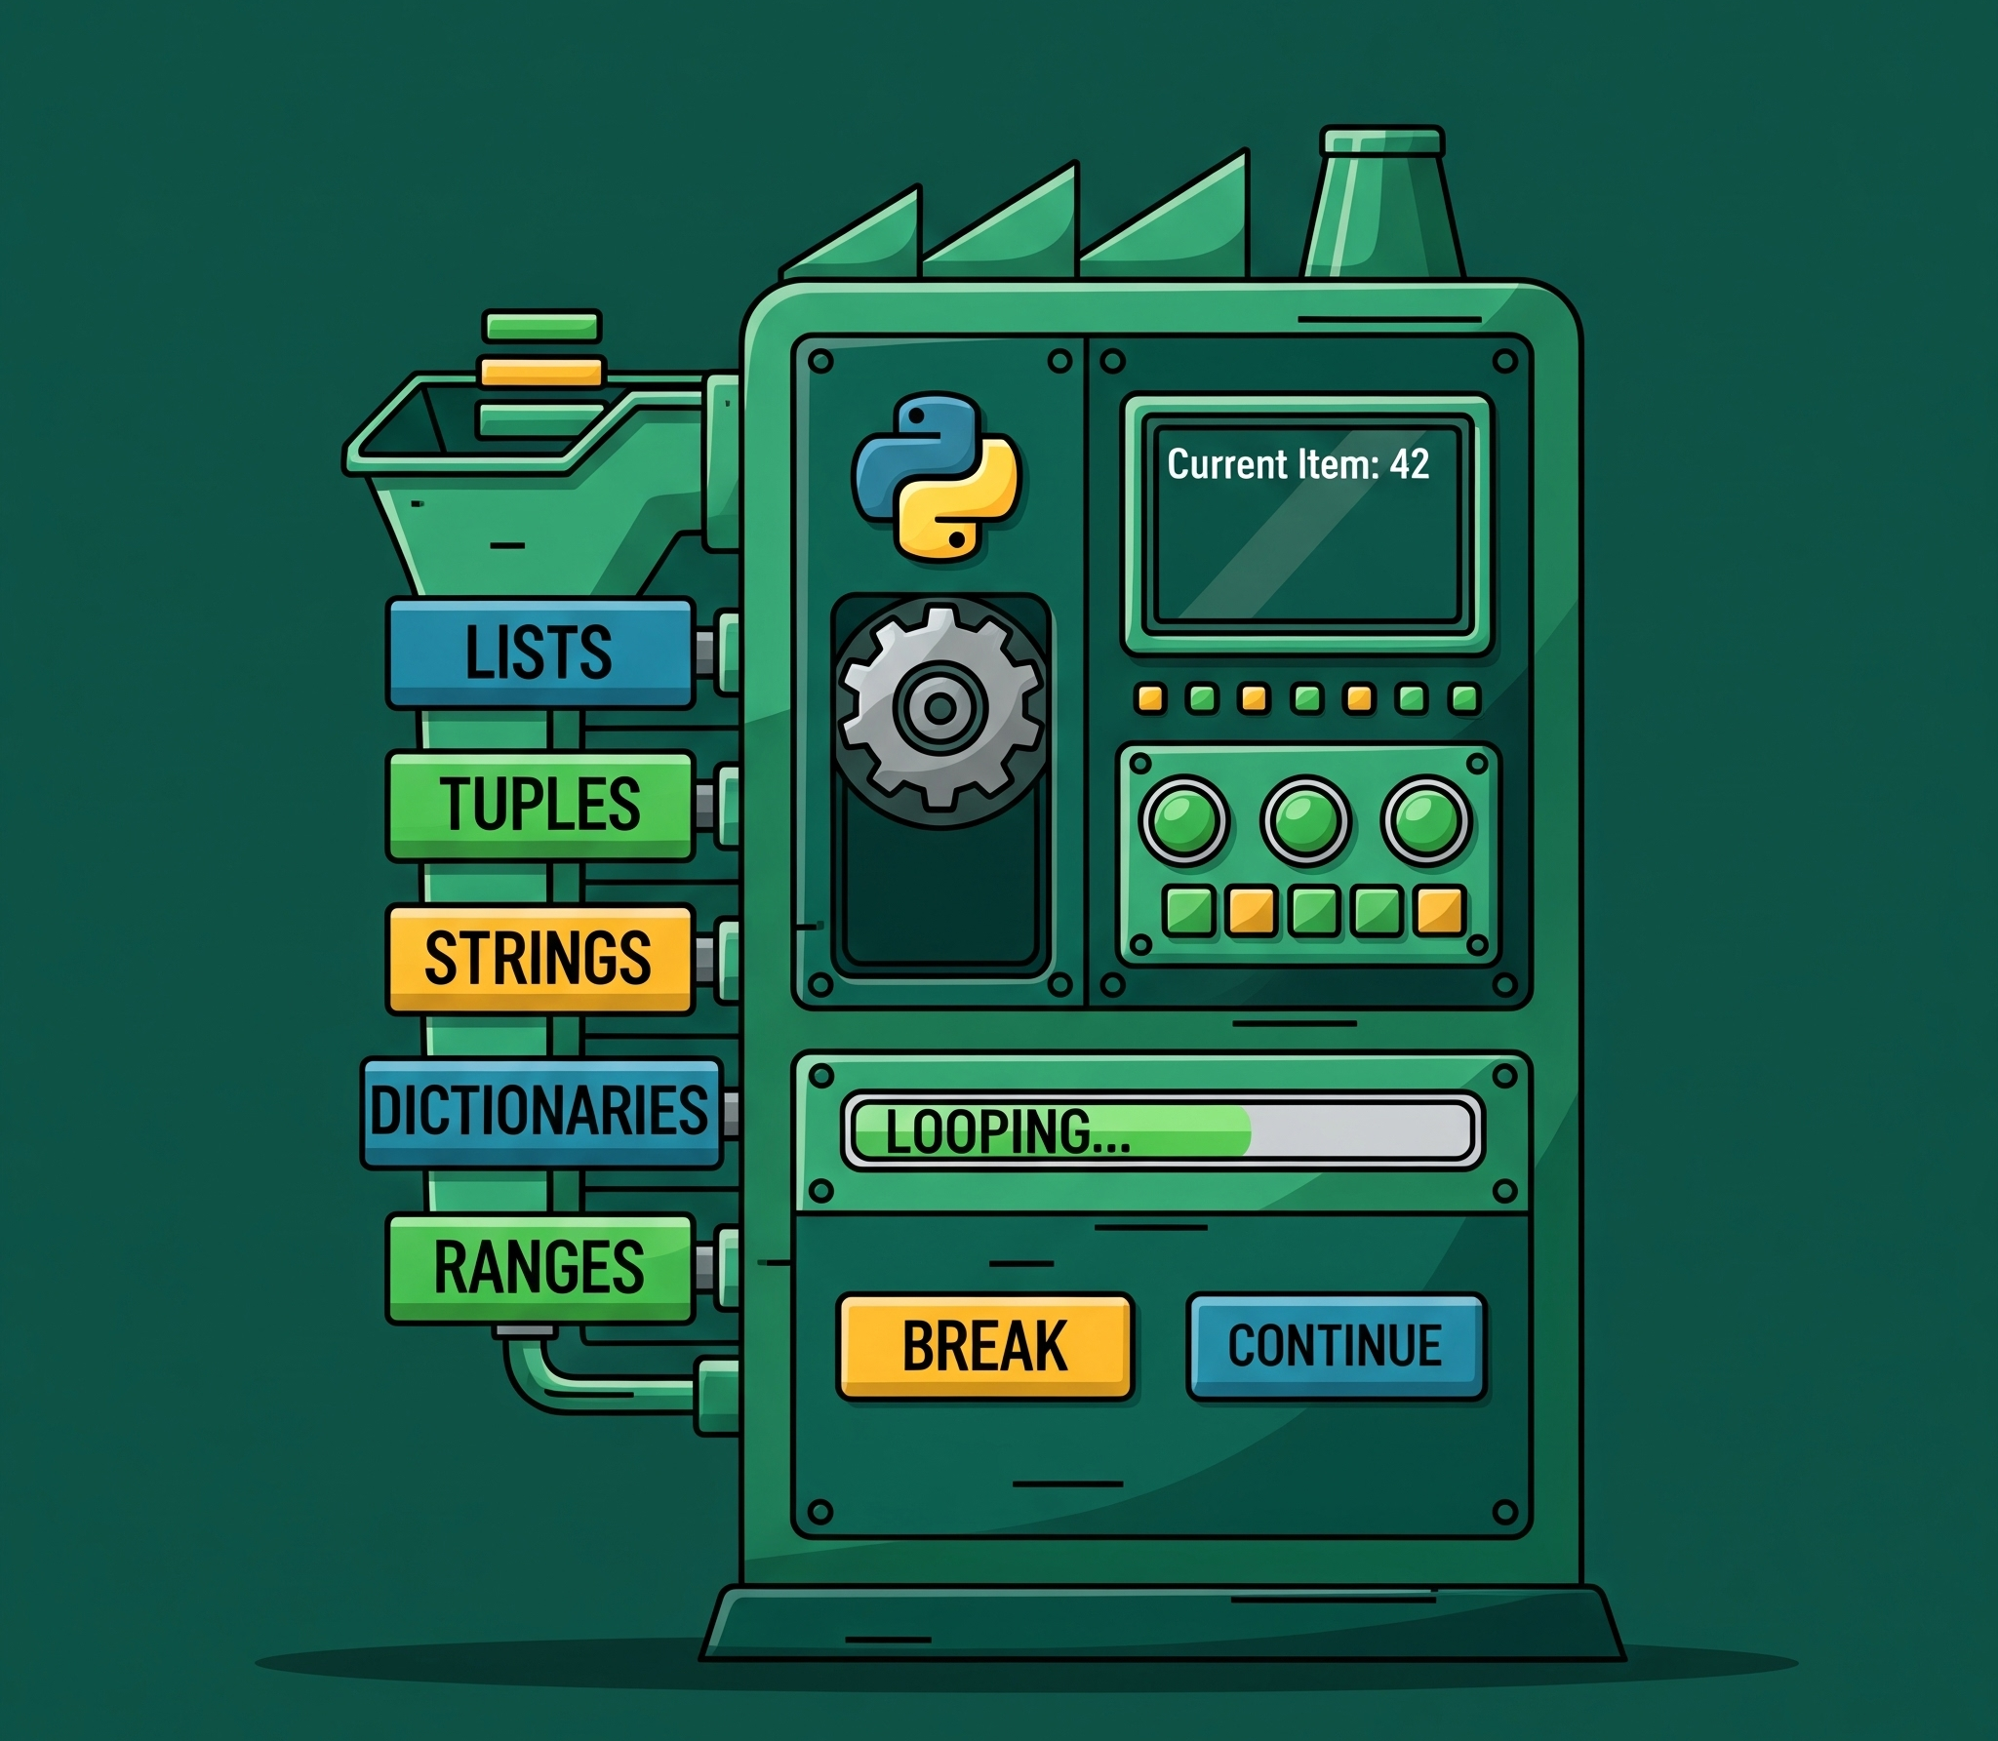
What are loops?
Executes blocks of code for a defined number of iterations.

Slide 4
Why use loops?
Reduces duplicate code and logic.
Helps readability.

Slide 5
How to implement loops in Python?
Loops in Python
For Loops
While Loops

Slide 6
For loops in Python: Syntax
for <VARIABLE> in <ITERABLE>:
# Do something
# End of loop

Slide 7
For loops in Python: Example
fruits = ["apple", "banana", "cherry"]
for fruit in fruits:
print(fruit)

Slide 8
For loops in Python: range()
fruits = ["apple", "banana", "cherry"]
for i in range(5):
print(i,“ x 7 = ”, i*7)

Slide 9
While loops in Python: Syntax
count = 0 # Value depends on logic
while <END_CONDITION>:
# Do something
count += 1 # Important! Will result in infinite loop otherwise.
# End of loop

Slide 10
While loops in Python: Example
fruits = ["apple", "banana", "cherry"]
count = 0
while count < len(fruits):
print(fruit)

Slide 11
When to use while over for?

Slide 12
Flow control in loops
break
Exits the loop during execution.
continue
Skips code below and goes to next iteration.
else
Code block that runs if a loop finishes normally i.e., no break.

Slide 13
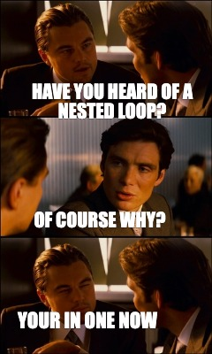
Nested loops: What?

Slide 14
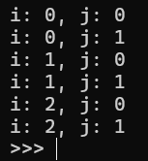
Nested loops in Python: Example
# Outer loop Output:
for i in range(3):
# Inner loop
for j in range(2):
print(f"i: {i}, j: {j}")

Slide 15
Thank you
ICT Learning Centre,
CS1-046,
CSIS Building,
University of Limerick,
http://ictlc.ul.ie/contactus

